Slide 1

Student Alcohol Consumption Data Science Project
Olufemi George

Slide 2
This data approach student achievement in secondary education of two Portuguese schools. The data attributes include student grades, demographic, social and school related features) and it was collected by using school reports and questionnaires. The goal is to determine the correlation (if any) between alcohol consumption by students and their grades in school. We will also be looking at the importance/relevance of other variables in determining grades in this dataset based on the best performing model.
Project Overview
Notes:
This is the question that your experiment answers

Slide 3
The Data
The data attributes include student grades, demographic, social and school related features)
Collected by using school reports and questionnaires.
Two datasets are provided regarding the performance in two distinct subjects: Mathematics (mat) and Portuguese language (por).
Both Datasets were merged and we ended up with 959 Observations and 33 variables.
17% of our data contains students that failed. This is an important step because if the proportion was smaller than 15%, it would be considered a rare event and would be more challenging to model.

Slide 4
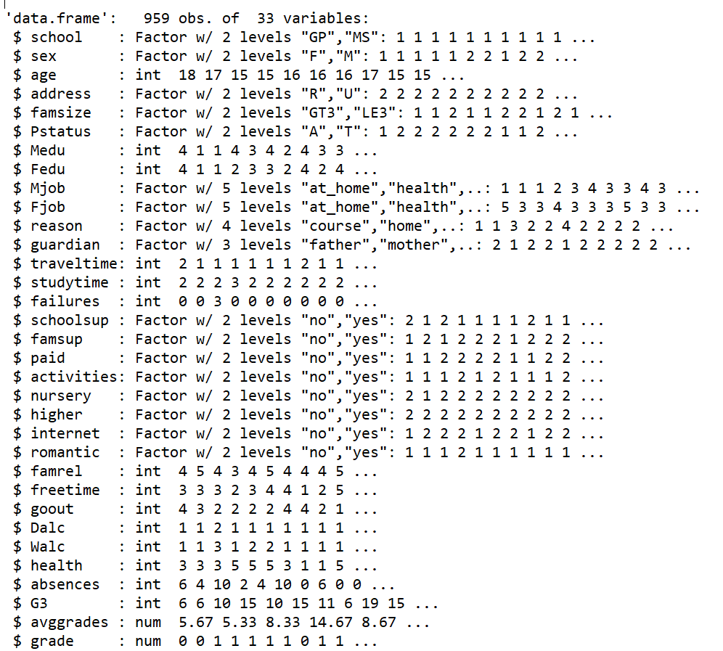
Example Data
Notes:
Summarize your research in three to five points.

Slide 5
Target Variable
There were 3 grades G1,G2, and G3 representing first, second and final grades respectively.
Created a P/F variable based on psssing mark for Schools in Portugal ( Exams are scaled on 0-20 with a pass mark of 9.
Notes:
Summarize your research in three to five points.

Slide 6
Exploratory Data Analysis
No missing values and data from both files had to be merged on common fields.
Used ggplot2 and plot (stats) to examine central tendency and distribution of continuous variables (G3).
Each category was converted into a separate binary variable with a value of either 1 or 0. This increased the number of variables from 32 to 53.
Notes:
Summarize your research in three to five points.

Slide 7
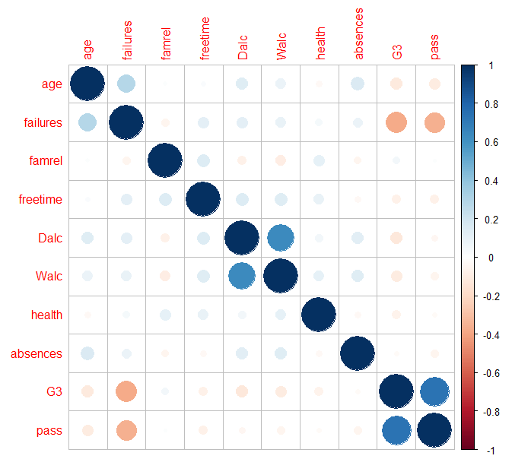
Testing correlation
Strong correlation between;
1) G3/failures
2) failures/pass
3) Walc/Dalc
4) age/failure
This shows that failure is a candidate for removal.
Notes:
Summarize your research in three to five points.

Slide 8
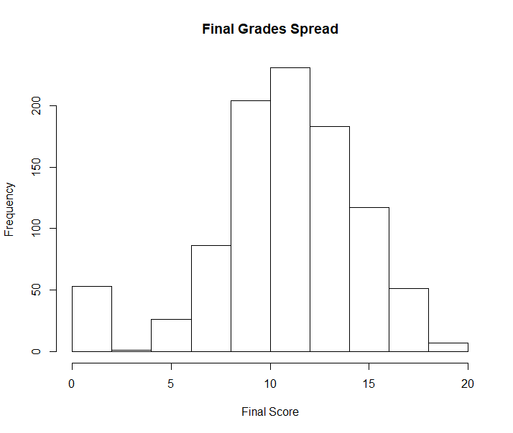
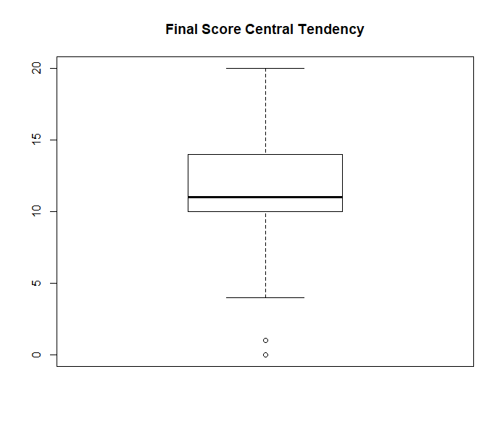
Exploring Final Score (G3)
Notes:
Summarize your research in three to five points.

Slide 9
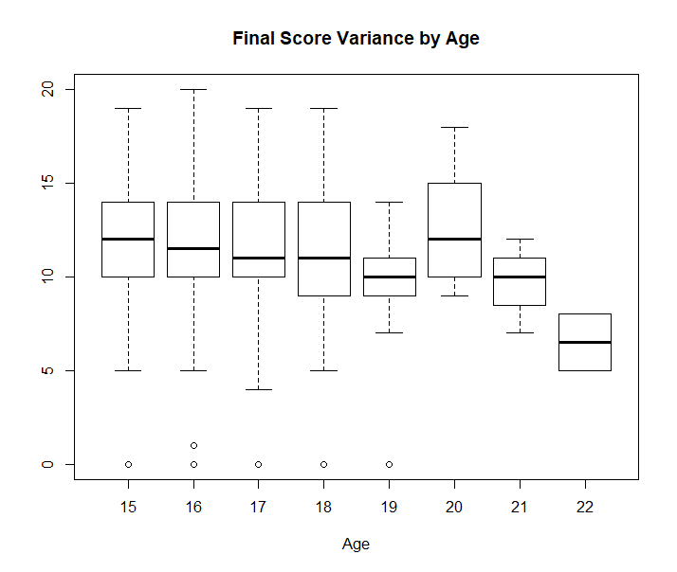
Age
The average final score and spread are relatively constant across the different ages between 15-19
The spread of scores of students who are 19 were was smaller than average and from 19 years, there was a slight decline in average final scores.
This could be due to other factors related to age eg romantic relationships, alcohol etc
Notes:
Summarize your research in three to five points.

Slide 10
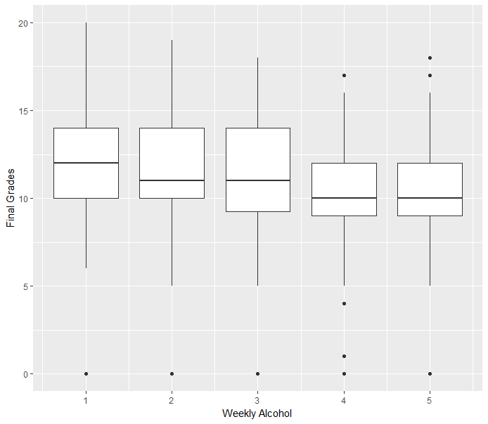
Alcohol Consumption and Final Grades
Notes:
Summarize your research in three to five points.

Slide 11
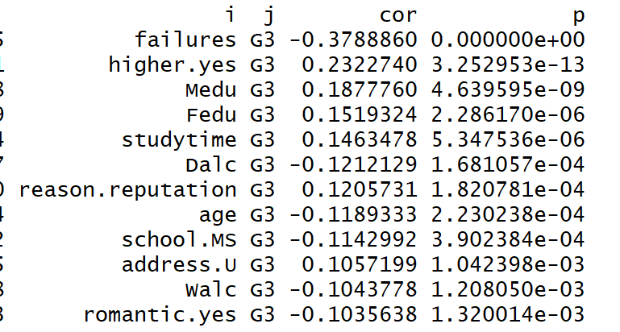
Variable Significance by Correlation
Used functions developed by Stephen Turner.
cor.prob will create a correlation matrix along with p-values and flattenSquareMatrix flattened all the combinations from the square matrix into a data frame of 4 columns made up of row names, column names, the correlation value and the p-value
Notes:
Summarize your research in three to five points.

Slide 12
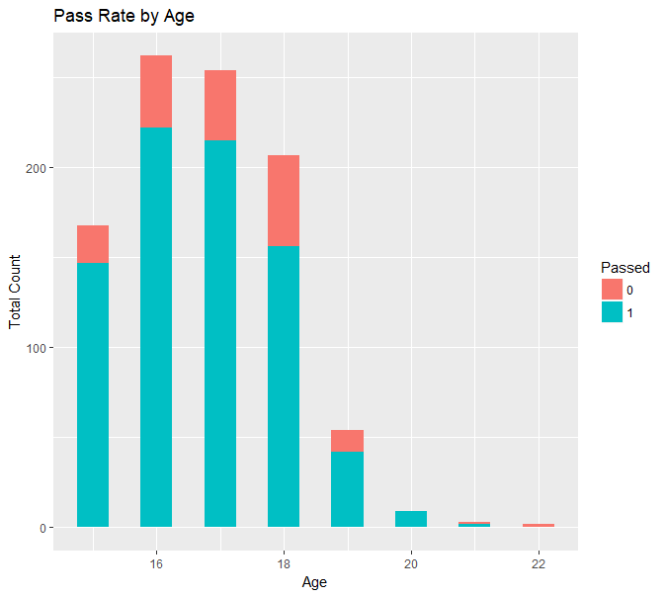
Add your answer / solution here
Pass Rate lowest for older Students
Notes:
Establish hypothesis before you begin the experiment. This should be your best educated guess based on your research.

Slide 13
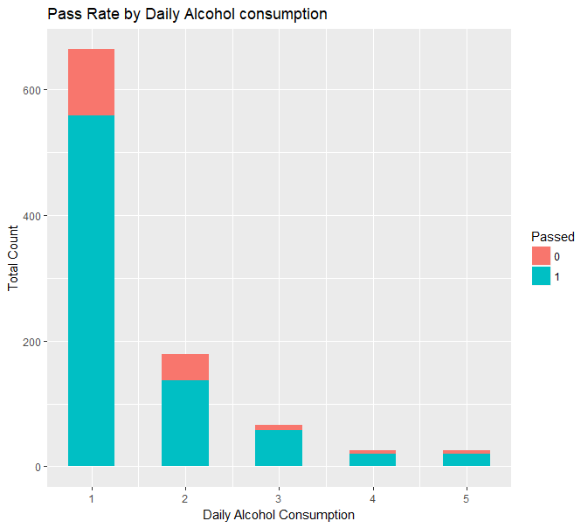
Add your answer / solution here
Increased Daily alcohol consumption reduces Pass rate
Notes:
Establish hypothesis before you begin the experiment. This should be your best educated guess based on your research.

Slide 14
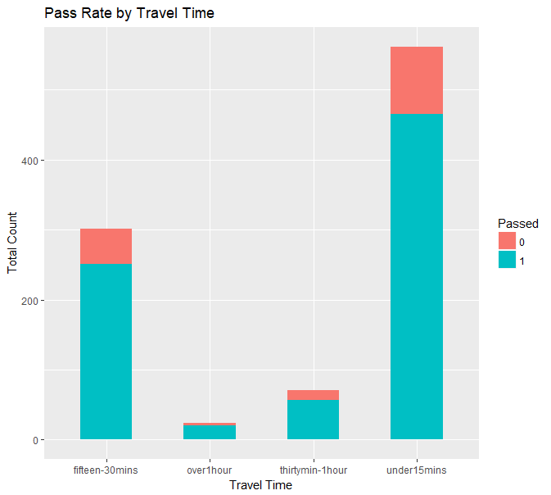
Add your answer / solution here
Increased travel time reduces Pass Rate
Notes:
Establish hypothesis before you begin the experiment. This should be your best educated guess based on your research.

Slide 15
Model choice considerations
Given that the data is all numeric, I would generally expect decision tree and rule-based methods to do well.
I would expect regression and instance-based methods to not do so well.
trainControl <- trainControl(method="repeatedcv", number=10, repeats=3)
metric <- "Accuracy"
# GLM set.seed(7) fit.glm <- train(pass~., data=trainDF, method="glm", metric=metric, preProc=c("center", "scale"), trControl=trainControl)
Notes:
Summarize your research in three to five points.

Slide 16
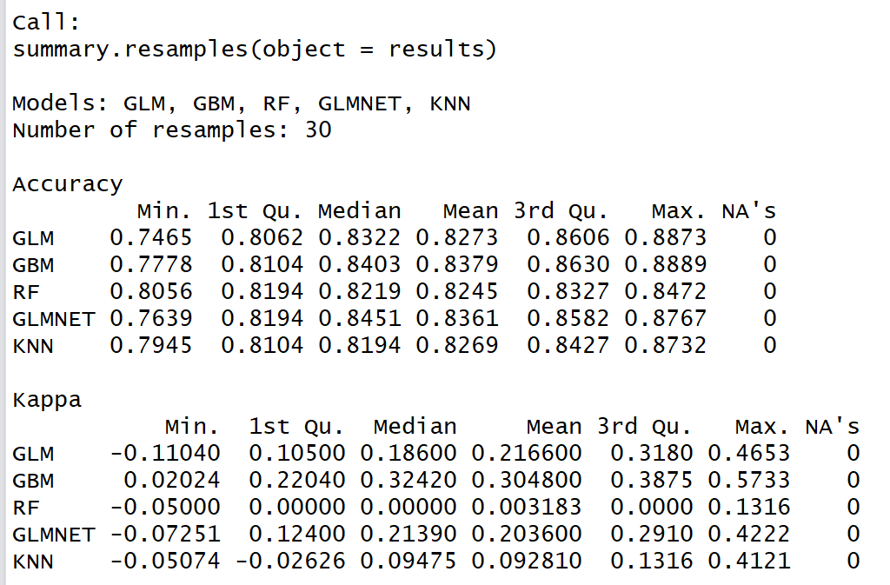
Algorithm results
Tested GLM, GBM, RF, GLMNET, KNN models without tuning and the metric was Accuracy.
Accuracy of GLMNET was the highest.
Notes:
Summarize your research in three to five points.

Slide 17
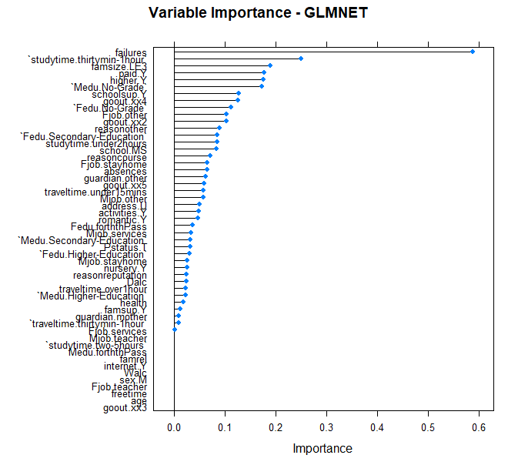
GLMNET Variable Importance (descending)
Failures
Studytime30mins-1hour
FamilySizeLE3
HigherY
Medu.Grade
SchoolSup.Y
Goout.xx4
Fedu.NoGrade
Notes:
Summarize your research in three to five points.

Slide 18
Dummy Variables
Step 1
Describe this step in your experiment
Step 2
Describe this step in your experiment
Step 3
Describe this step in your experiment
Step 4
Describe this step in your experiment
Notes:
List all of the steps used in completing your experiment.
Remember to number your steps.

Slide 19
Variables
Controlled variables
Independent variable
Dependent variable
These are kept the same throughout your experiments
The one variable you purposely change and test
The measure of change observed because of independent variable
Decide how you will measure the change

Slide 20
Analysis
Hypothesis
Notes:
Establish hypothesis before you begin the experiment. This should be your best educated guess based on your research.

Slide 21
Analysis
First research point
Second research point
Third research point
Notes:
Summarize your research in three to five points.

Slide 22
Feature Importance
First research point
Second research point
Third research point
Notes:
Summarize your research in three to five points.

Slide 23
Conclusion
Brief summary of what you discovered based on results
Indicate and explain whether or not the data supports your hypothesis

Slide 24
Materials
Materials (detailed list) | Quantity (be specific)
Item | Amount
Item | Amount
Item | Amount
Item | Amount
Item | Amount
Item | Amount
Item | Amount

Slide 25
Procedure
Step 1
Describe this step in your experiment
Step 2
Describe this step in your experiment
Step 3
Describe this step in your experiment
Step 4
Describe this step in your experiment
Notes:
List all of the steps used in completing your experiment.
Remember to number your steps.

Slide 26
Data/Observations
Include Observation based on the data from your experiments

Slide 27
Works Cited
Include print and electronic sources in alphabetical order
http://archive.ics.uci.edu/ml/datasets/student+performance

